Slide 1


Different levels of complexity in teaching the Spectrum: Focusing on the reproduction cluster
Prof. Nikolaos Digelidis
University of Thessaly
Department of PE & Sport Sciences

Slide 2
The Spectrum in Greece
1992: Presentation of the Spectrum in Athens, Greece
1996: Mosston & Ashworth book (1986 edition) published in Greek
1998: First webpage with information about the Spectrum of teaching styles
2006: The Spectrum is incorporated in the official PE books for grades 5-9
2007: Book on lesson design using the Spectrum of teaching styles
2007: First international symposium for the Spectrum (FEPSAC Congress)
2012: Mosston & Ashworth (2008 edition) translated by Chatoupis
2015: The Spectrum was incorporated into the new PE curriculum for the upper senior high school (grades 10-12)

Slide 3



At least 3 books in Greek, but wait…

Slide 4

People still get inspired by the Spectrum… teaching wrestling with the use of the Spectrum

Slide 5
Research with the Spectrum in Greece
(sample references)
Chatoupis, C., & Emmanuel, C. (2003). The effects of two disparate instructional approaches on student self-perceptions in elementary physical education. European Journal of Sport Science, 3(1), 1-16
Kolovelonis, A., Goudas, M., & Gerodimos, V. (2011). The effects of the reciprocal and the self-check styles on pupils’ performance in primary physical education. European Physical Education Review, 17(1), 35-50.
Kolovelonis, A., & Goudas, M. (2012). Students' recording accuracy in the reciprocal and the self-check teaching styles in physical education. Educational Research and Evaluation, 18(8), 733-747.
Papaioannou, A., Theodosiou, A., Pashali, M., & Digelidis, N. (2012). Advancing task involvement, intrinsic motivation and metacognitive regulation in physical education classes: The self-check style of teaching makes a difference. Advances in Physical Education, 2(03), 110.
Patmanoglou, S., Digelidis, N., & Tsigilis, N. (2008). The Command and Self-Check Styles for more effective teaching of tennis at the elementary school. International Journal of Physical Education, 45(1), 26-32.
Syrmpas, I., & Digelidis, N. (2014). Physical education student teachers' experiences with and perceptions of teaching styles. Journal of Physical Education and Sport, 14(1), 52.
Syrmpas, I., Digelidis, N., & Watt, A. (2016). An examination of Greek physical educators’ implementation and perceptions of Spectrum teaching styles. European Physical Education Review, 22(2), 201-214.

Slide 6

Teacher education and the Spectrum
University of Thessaly was the first to include the Spectrum in student teachers’ educational program before ~20 years
Right now, more or less, all 5 Schools of Physical Education and Sport Science teach the Spectrum

Slide 7
A developing student-teacher in UTH
 | Theory | Practice
1st year of study | Sport pedagogy and sport sciences courses | Micro-teaching to fellow-students Introduction to the Spectrum during the 1st semester (one lecture) and full teaching of the Spectrum during the 2nd semester
2nd year of study | Sport pedagogy and sport sciences courses | Micro-teaching and internships at schools (elementary level) 3rd semester there is a “PE lab” and 4th follows teaching at school with the Spectrum
3rd year of study | Pathway of specialization | Micro-teaching and internships at schools (secondary level) Micro-teaching and internships at several sectors and places (schools/gyms/private or public sector etc)
4th year of study | Pathway of specialization | Micro-teaching and internships at several sectors and places (schools/gyms/private or public sector etc)

Slide 8
The need for teaching lesson design procedures to students
Students do not have enough experience in lesson design, and it takes time to see an impact from their studies
They tend to reproduce their teachers’ behaviors

Slide 9
The “two balls” phenomenon!

Slide 10
The practice style of teaching…
Άσκηση 1
Άσκηση 2
Άσκηση Μετάβασης
Άσκηση 1
Άσκηση 2
Άσκηση Μετάβασης
Άσκηση 1
Άσκηση 2
Άσκηση Μετάβασης
Άσκηση 1
Άσκηση 2
Άσκηση Μετάβασης

Slide 11
The Spectrum gives us many possible “paths” for teaching and learning
Many of these paths are different from what we have been used to as students at school
Giving choices to students increases the level of complexity in teaching

Slide 12
The 3 “revelations” of teaching the Spectrum to teachers…
Teachers at schools tend to:
  Reproduce (at least partly) what they had experienced when they were students at school
  Prefer controlling teaching approaches vs autonomy promotion (Reeve, 2009)
  Resist to changes in their daily working routines (Goodson et al, 2006; Snyder, 2017)

Slide 13

Lesson design using the Spectrum: Let’s see some examples

Slide 14
Lesson design with the practice style (B)

Slide 15
Task card design with the practice style
Elements of a task card:
  Task card’s objective(s)
  Guidelines for the student on how to use the card
  Drills’ description (pictures help)
  Transition’s drill
  Students’ choices

Slide 16
An example for the practice style (ideally)
Objective: To practice passing skills in volleyball
Guidelines: Make pairs, take a ball and try the following drills:
  One pass to yourself and one to your pair (20 repetitions).
  20 consecutive passes.
  One tall pass, one low pass (20 repetitions).
You can skip one exercise, if you want
Transition: How many times can you exchange passes consecutively with your pair?

Slide 17
Teaching without task cards
What’s the simplest example for the practice style?

Slide 18
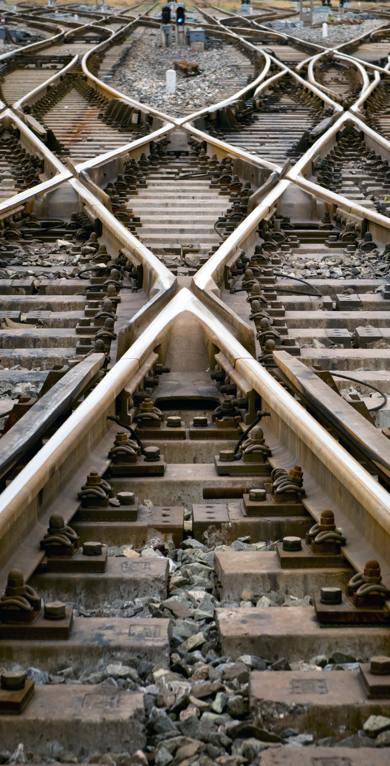
Self-regulated lesson design with the practice style
One drill per station – no choices
One drill per station – no choices - use of transition drill
More drills per station – no choices – use of transition drill
More drills per station – at least one choice to students – use of transition drill

Slide 19
Question for reflection
What other choices can we give to students?

Slide 20
Lesson design with the reciprocal style (C)

Slide 21
Task card design with the reciprocal style
Task card’s objective(s)
Guidelines for the student who observe (e.g. what are the criteria for proper execution, what do we observe, how many times do we observe before giving feedback, what kind of feedback we give etc).
Guidelines for the student who will execute the drill (e.g. description of drills, choices, etc).
Picture or drawing for better understanding

Slide 22

Teaching without task cards
What’s the simplest example for the reciprocal style?

Slide 23
Self-regulated lesson design with the reciprocal style
One skill or drill – one key-point for observing
More drills – one key-point for observing
One drill – many key-points – one key-point at a time
More drills – many key-points at the same time

Slide 24
Question for reflection
What types of feedback can students provide to their mates?

Slide 25

Lesson design with the self-check style (D)

Slide 26
Task card design with the self-check style
Task card’s objective(s)
Guidelines for the student (e.g. what are the criteria for proper execution, what do we check or assess, etc).
Picture or drawing for better understanding

Slide 27
Self-regulated lesson design with the self-check style
Similarly with the reciprocal style

Slide 28
Self-regulated lesson design with the self-check style
One skill or drill – one key-point for observing
More drills – one key-point for observing
One drill – many key-points – one key-point at a time
More drills – many key-points at the same time

Slide 29
Question for reflection
Is it possible to apply the self-check style while having group drills and not individual ones?

Slide 30
Surprise questions!
What’s the most complex example for the self-check style?
Can you apply it without a task card?

Slide 31

Lesson design with the inclusive style (E)

Slide 32
Lesson design with the inclusive style
Choose an exercise or a skill.
Analyze exercise’s or skill’s parameters.
Decide which decisions you are going to aloud students to change.

Slide 33
Self-regulated lesson design with the inclusive style
1. Describe drills or exercises with a different level of difficulty and let students choose
2. Describe one exercise and the parameters that students may choose to alter
  One drill – one parameter to alter
  One drill – more parameters – one parameter per time
  One drill – more parameters – alter more than one parameter at the same time and make combinations

Slide 34

1. Describe 3 exercises with a different level of difficulty and let students choose
How are you going to execute push-ups?
How many push-ups will you make?
5 10 15
Α
Β
Γ

Slide 35

The inclusion style is (perhaps) the most appropriate or easy to combine with any other teaching style

Slide 36
2. Describe one exercise and the parameters that students may choose to alter
Push-ups
Try to modify…
How open will you put your hands
How open will you keep your feet
Knees’ angle
Done
√
√
Inclusive plus self-check style

Slide 37

Question for reflection
How can we combine the inclusion style with...? Can you give me an example of a combination with other styles that you are familiar?

Slide 38
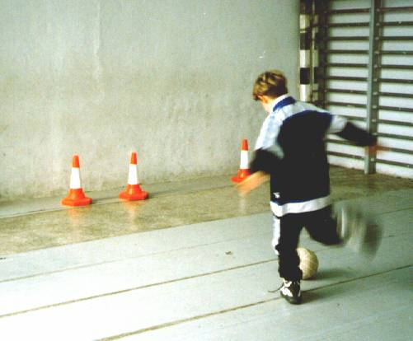
The inclusive style without task cards

Slide 39
Epilogue

Slide 40
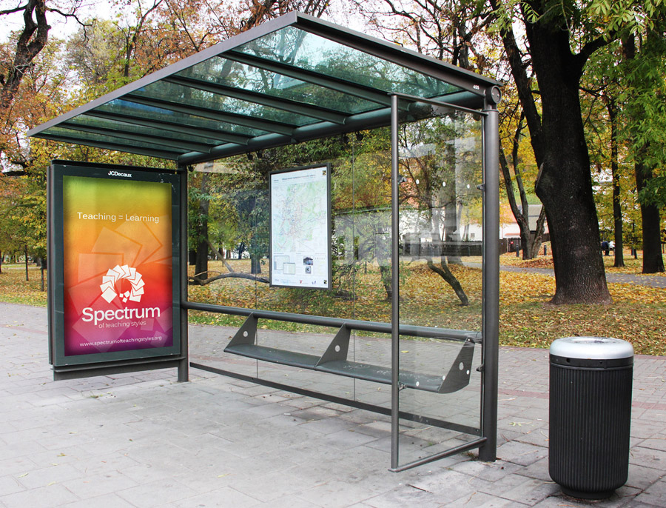
Conclusion
We need to think differently about educating student-teachers with the Spectrum and we still need to learn…

Slide 41


